Slide 1

Gateway to Diplomacy: Middle School Model UN, Building Negotiation and Compromise!
Pamela S. Roach
North Cobb High School
Kennesaw State University
Christa Evans Heath
Holcomb Bridge Middle School

Slide 2
Why Should Students Participate in Model United Nations?
Model U.N. promotes student and teacher interest in international relations and related subjects, increases the capacity for students to engage in problem solving, teaches aspects of conflict resolution, research skills, and communication skills, and creates the opportunity to meet new people and make new friends.

Slide 3
Famous Model UN Members
US Supreme Court Justice Stephen Breyer
Former World Court Justice Stephen M. Schwebel
ABC's This Week anchor George Stephanopoulos
Former first - daughter Chelsea Clinton
Under-Secretary General for Public Information, Kiyotaka Akasaka
UN Secretary - General, Ban Ki-Moon
Actor Samuel L. Jackson
Ryan Seacrest from American Idol
Rainn Wilson - Dwight from The Office
Patricia Avery - University of Minnesota

Slide 4

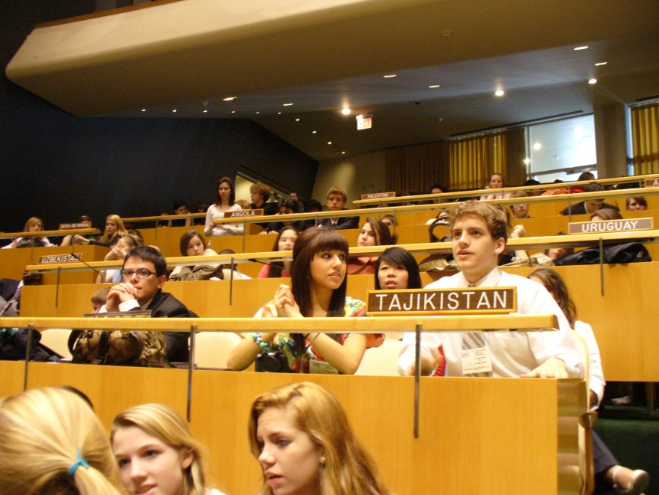
Who’s Involved?
400 Conferences in 35 Countries
Over 400,000 Students Middle School and Above Each Year
Project ICONS
online simulation

Slide 5
Introduction of CCGPS

Slide 6
Social Studies GPS
SS8CG1
c. Describe the rights and responsibilities of citizens.

Slide 7
6-8th Grade Literacy in History / Social Studies, Science, and Technical Subjects Common Core Georgia Performance Standards (ELACCGPS)
Text Types and Purposes
ELACC6-8WHST1: Write arguments focused on discipline-specific content.
a. Introduce claim(s) about a topic or issue, acknowledge and distinguish the claim(s) from alternate or opposing claims, and organize the reasons and evidence logically.
b. Support claim(s) with logical reasoning and relevant, accurate data and evidence that demonstrate an understanding of the topic or text, using credible sources.
c. Use words, phrases, and clauses to create cohesion and clarify the relationships among claim(s), counterclaims, reasons, and evidence.
d. Establish and maintain a formal style.
e. Provide a concluding statement or section that follows from and supports the argument presented.
ELACC6-8WHST2: Write informative/explanatory texts, including the narration of historical events, scientific procedures/ experiments, or technical processes.
a. Introduce a topic clearly, previewing what is to follow; organize ideas, concepts, and information into broader categories as appropriate to achieving purpose; include formatting (e.g., headings), graphics (e.g., charts, tables), and multimedia when useful to aiding comprehension.
b. Develop the topic with relevant, well-chosen facts, definitions, concrete details, quotations, or other information and examples.
c. Use appropriate and varied transitions to create cohesion and clarify the relationships among ideas and concepts.
d. Use precise language and domain-specific vocabulary to inform about or explain the topic.
e. Establish and maintain a formal style and objective tone.
f. Provide a concluding statement or section that follows from and supports the information or explanation presented.
ELACC6-8WHST3: (See note; not applicable as a separate
Production and Distribution of Writing
ELACC6-8WHST4: Produce clear and coherent writing in which the development, organization, and style are appropriate to task, purpose, and audience.
ELACC6-8WHST5: With some guidance and support from peers and adults, develop and strengthen writing as needed
by planning, revising, editing, rewriting, or trying a new approach, focusing on how well purpose and audience have been addressed.
ELACC6-8WHST6: Use technology, including the Internet, to produce and publish writing and present the relationships between information and ideas clearly and efficiently.
Research to Build and Present Knowledge
ELACC6-8WHST7: Conduct short research projects to answer a question (including a self-generated question), drawing on several sources and generating additional related, focused questions that allow for multiple avenues of exploration.
ELACC6-8WHST8: Gather relevant information from multiple print and digital sources, using search terms effectively; assess the credibility and accuracy of each source; and quote or paraphrase the data and conclusions of others while avoiding plagiarism and following a standard format for citation.
ELACC6-8WHST9: Draw evidence from informational texts to support analysis reflection, and research.
Range of Writing
ELACC6-8WHST10: Write routinely over extended time.

Slide 8
CCGPS
ELACC6-8WHST1: Write arguments focused on discipline-specific content.
a. Introduce claim(s) about a topic or issue, acknowledge and distinguish the claim(s) from alternate or opposing claims, and organize the reasons and evidence logically.
b. Support claim(s) with logical reasoning and relevant, accurate data and evidence that demonstrate an understanding of the topic or text, using credible sources.
c. Use words, phrases, and clauses to create cohesion and clarify the relationships among claim(s), counterclaims, reasons, and evidence.
d. Establish and maintain a formal style.
e. Provide a concluding statement or section that follows from and supports the argument presented.

Slide 9
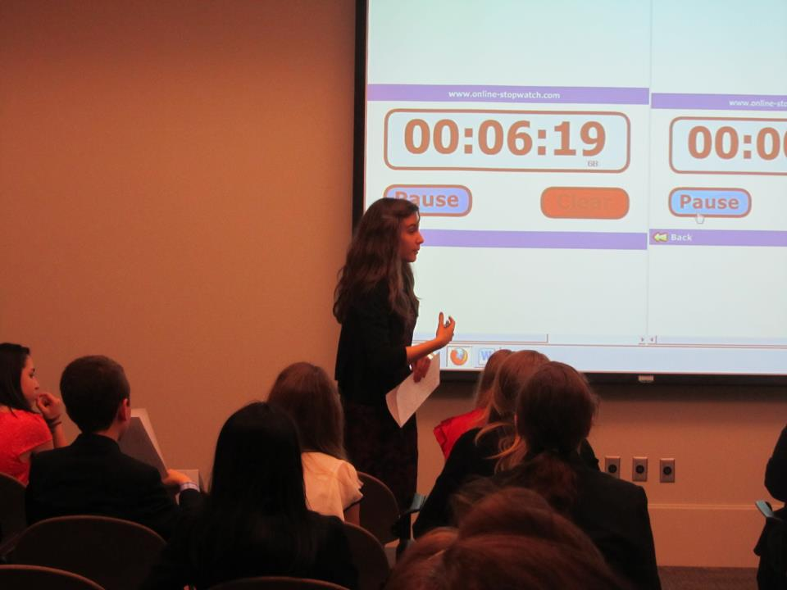
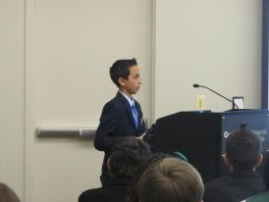
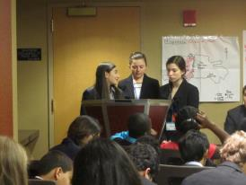
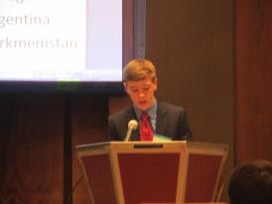
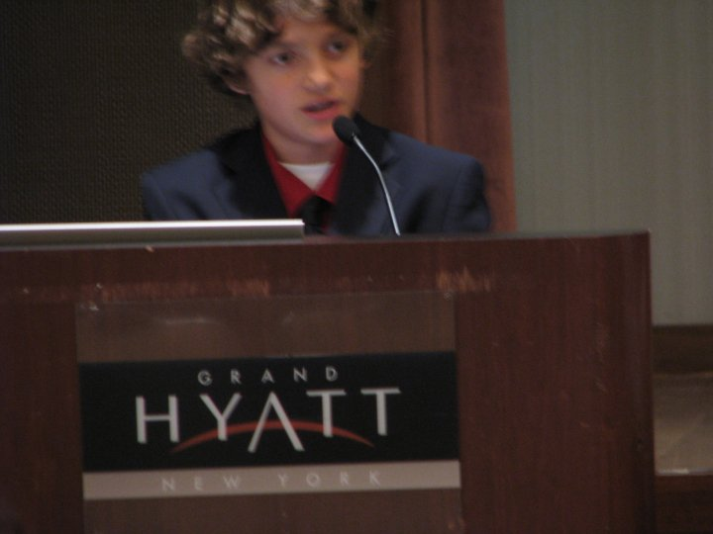
Public Speaking

Slide 10
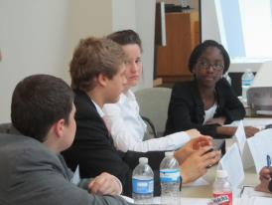
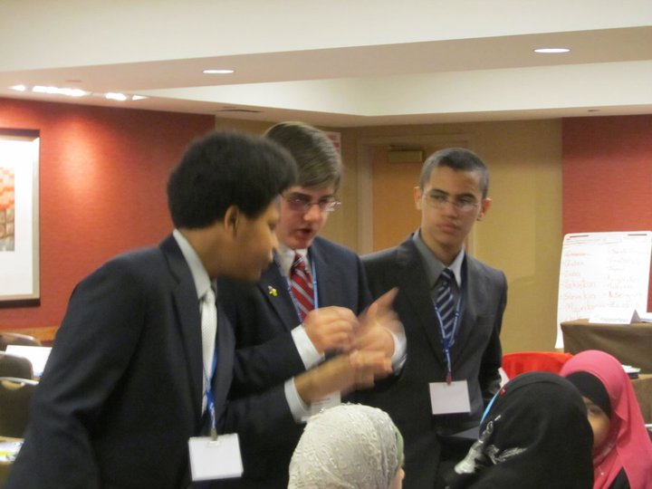
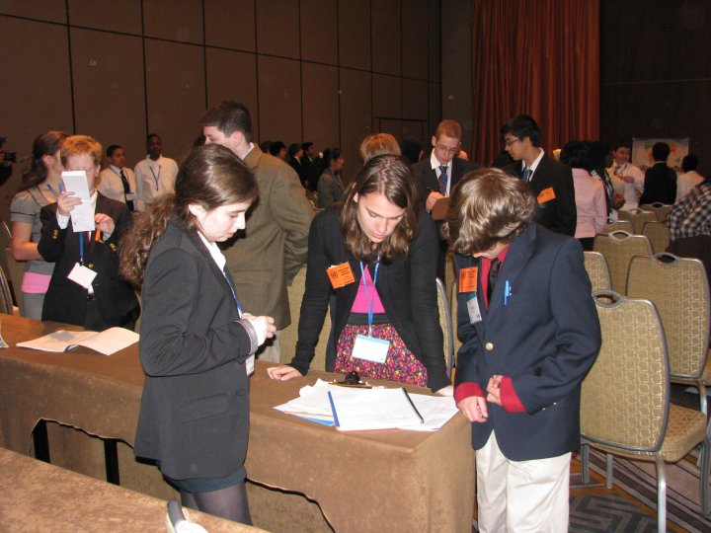
Negotiation

Slide 11
Research & Resolution Writing

Slide 12
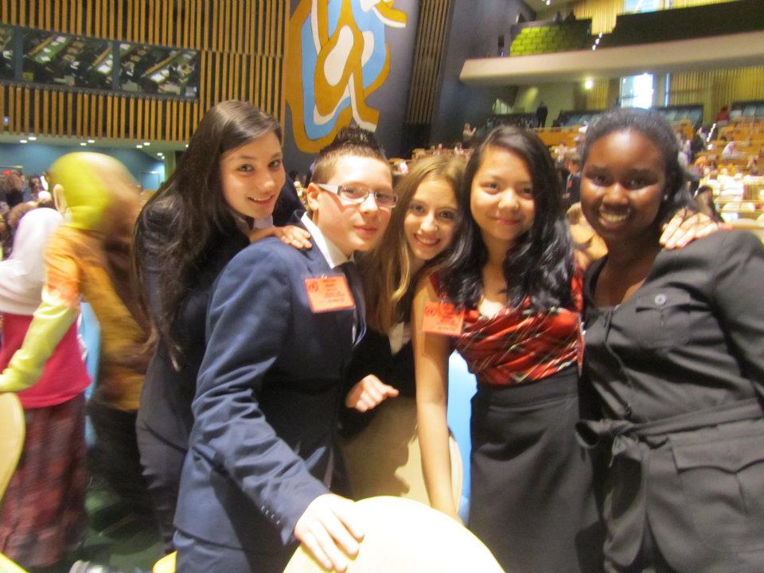
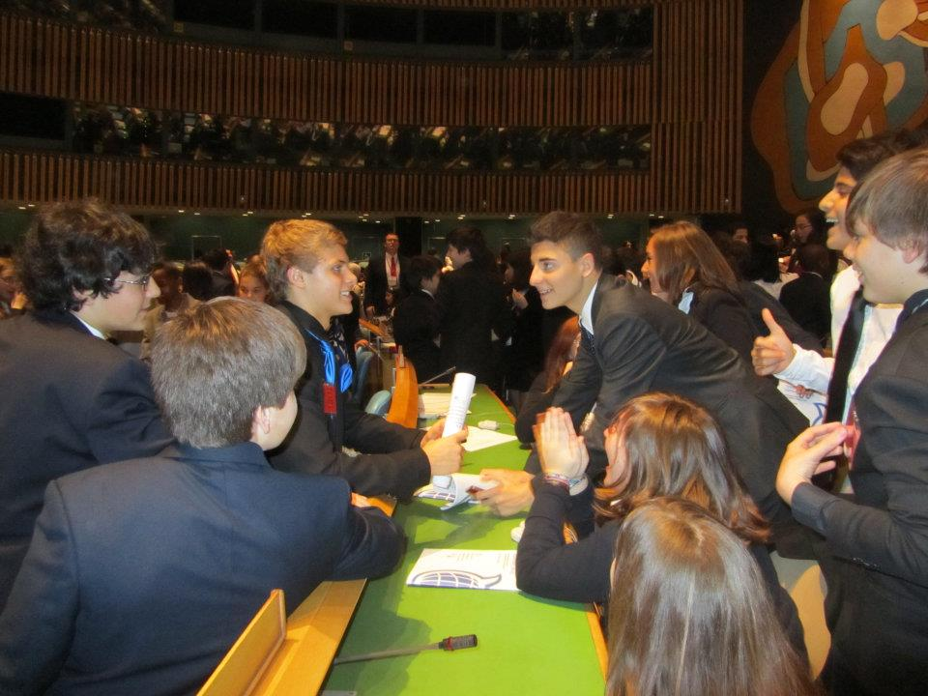
Relationship Building

Slide 13
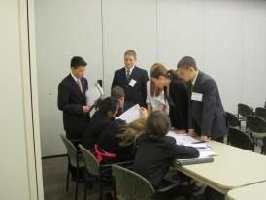
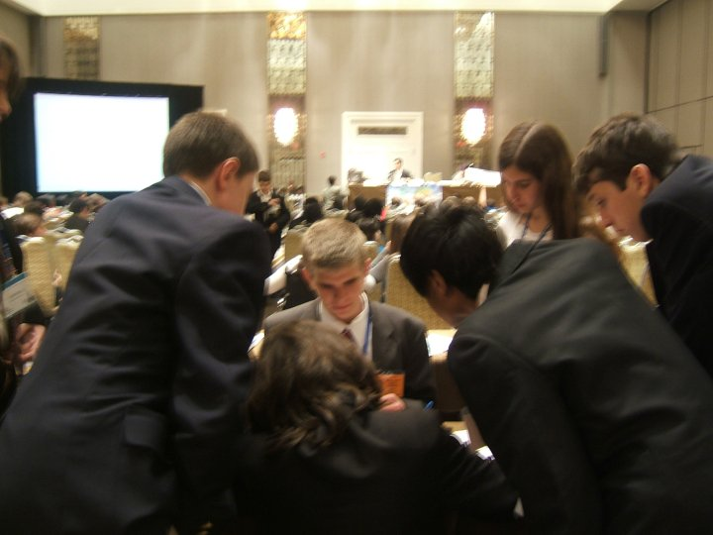
Collaborating

Slide 14
Leadership
Secretary General – runs New Delegate Conference & 8th MUN Learning Conference
Under-Secretary General - communications
Head Delegates – plan meetings
Country Chairs – ensure all papers and forms submitted
Committee Chairs – edit position papers

Slide 15
How To Get Started
Time
After School
Enrichment
Build Foundation
Understanding Procedures
Current Events
Start Small And Build
Local Conferences
Small Team
Proper Selection
Interview Process

Slide 16
How To Retain Delegates
Time
Before School 7:40am Wed ?
NDMUN
Build Tradition
Mentors / Buddy System
MUN Handbook
TEAM
Incentives
Conferences
Small Motivated Teams
Fees & Forms before Country/Committee Assignments
Proper Selection
Application Process for leadership and travel conferences
Stakeholders – student run if poss.
Opportunities to practice democracy

Slide 17
Resources
http://www.unausa.org/
http://cyberschoolbus.un.org/

Slide 18
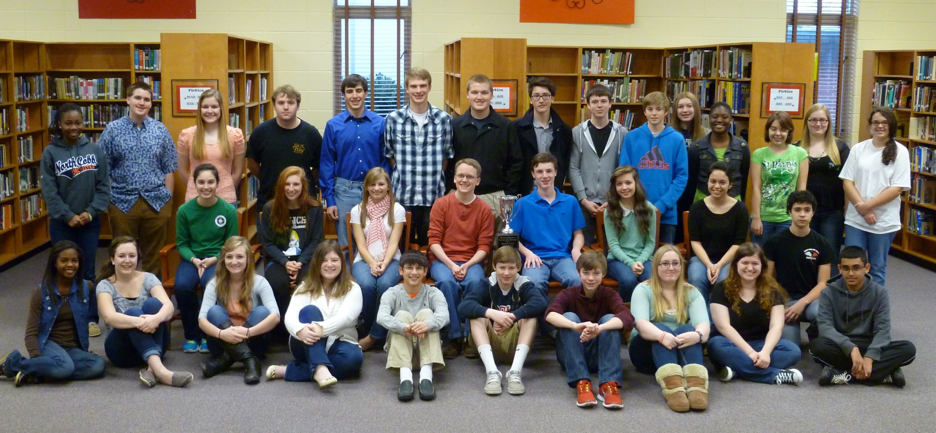
Running Your Own Conference
Or other fundraisers…Conference

Slide 20
NCHSMUN Learning Conference – October 13th, 2012 -- WORKSHOP SESSIONS --
Public speaking and confidence Rory, Megan, &Whitney
Build everyone’s confidence /ability (3rd person!)
  Also: Remind them to speak as often as possible
How should speeches be organized?
  Also: How to critique issue positions diplomatically
Caucusing and Resolution Writing Will, Jeel, Alexys
I.-how to write resolutions (Preambulatory and action)
II. a) How should students behave diplomatically in unmoderated caucus situations?
b) Require them to be standing at all times in Unmoderated caucuses
c) What should you do if one delegate takes control? etc.
Understanding Rules /Procedures David, Austin, & Adrianne
Go over rules and parliamentary procedure
Apply the rules to some fun goal, as we do in meetings (e.g. “motion to go to lunch”)

Slide 21
Implementing
Lunch – Country Briefings
Home Government - Sean
AFTERNOON
The committee willl consider the topic of the Falkland Islands (Malvinas) sovereignty dispute.
North Korea – GA & Uniting for Peace
Chairs David, Megan and Mary Francis
Proper Motions & Sovereignty

Slide 22
Leadership Running a MUN
Teamwork- Everyone has an area of expertise, and getting every person to their area can be hard at first. Once we had it worked out though, everything worked very well. I think it is possible for a lot of feet to get stepped on in a process like this, and many definitely did because none of us really like our peers telling us what to do and how to do it. I think we definitely got better about that this fall, but we can still work on making this a team effort where every NC delegate plays an important role in the decision making process. Our fall Training conference would not have been so awesome, for example, if Megan hadn't agreed to help me with the crisis at the last minute. Adding this jump into uncharted territory for us, we learned some "dos" and "don'ts" of planning a crisis. We also found out that we have a great crisis planner who can head up the secret crisis preparation committee for the Spring 8th Grade Conference....cough cough... Megan.
2013 Secretary General

Slide 23
Leadership Running a MUN
Being Responsible for Something- I think it was great the way that you and the other FAs played a supervisory/advisory role in the conference by getting us set up with facilities and the financial resources we needed and then letting the leadership team go to work. You guys gave us advice and let us know when something really wouldn't work, but you also let us learn how to take responsibility for getting things done. I think this taught every person involved that we are each ultimately responsible for what happens on conference day, which motivates everybody to do the best job that they can. 2013 Secretary General

Slide 24
More Leadership
How Conferences Actually Work- I have a new appreciation for the conferences we attend. It is much easier now for me to see how GSU could possibly not have their certificates printed to give out on the day of the conference, because we totally forgot about certificates at our 1st fall conference until about 45 minutes before closing ceremonies started. I think we also start to see things the way a chair or Secretary-General would, including the way we would like to see committee debate go, and what the chair might look for in an effective delegate. We also have a better knowledge of the workings of Model UN because we have had to write rules and country briefings, manage logistics, and guide a committee through the debate, etc. process

Slide 25
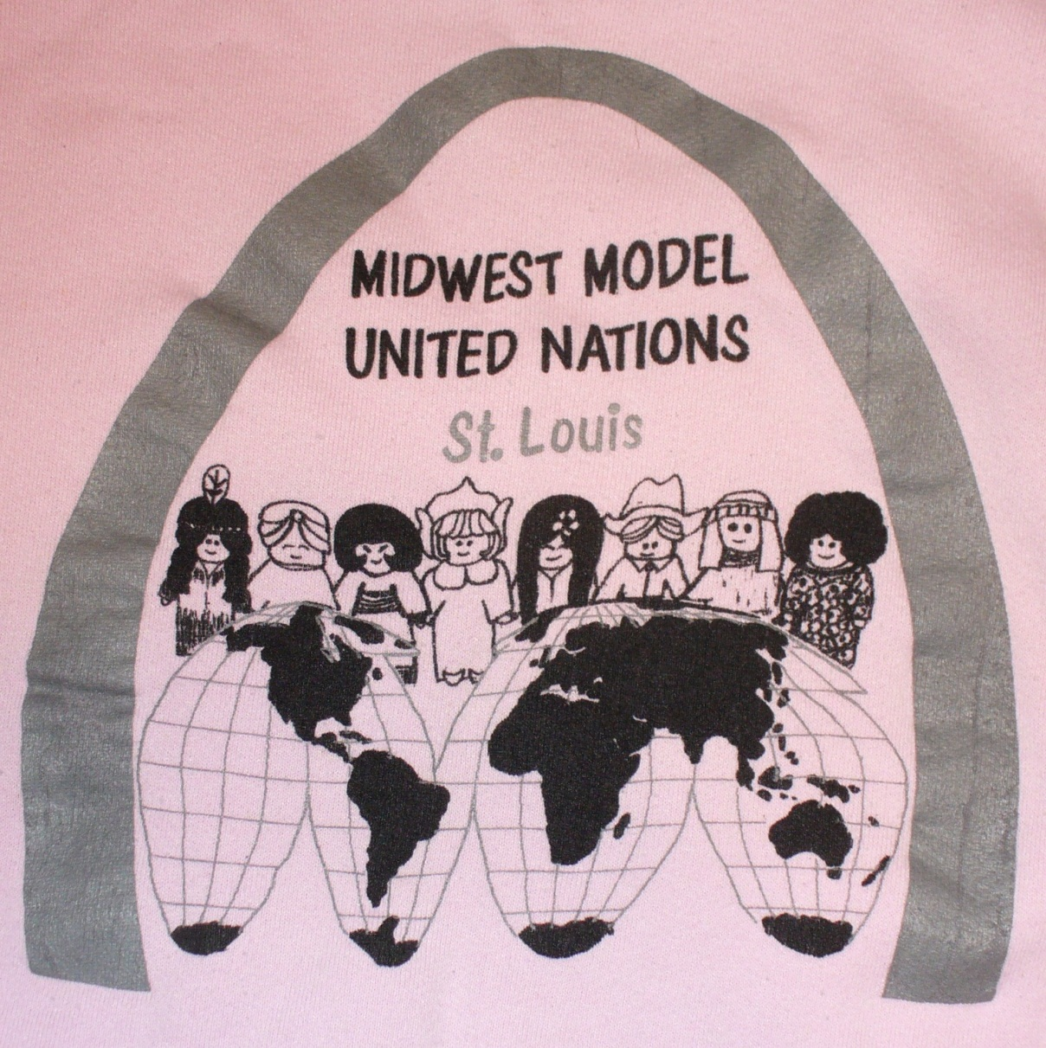
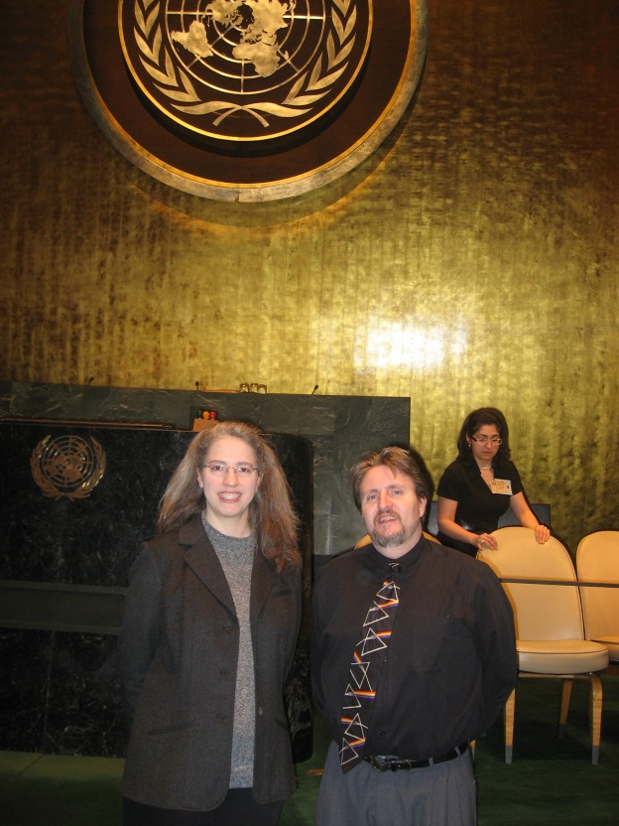
From Delegate to FA
Arkansas State University MUN Alums

Slide 26
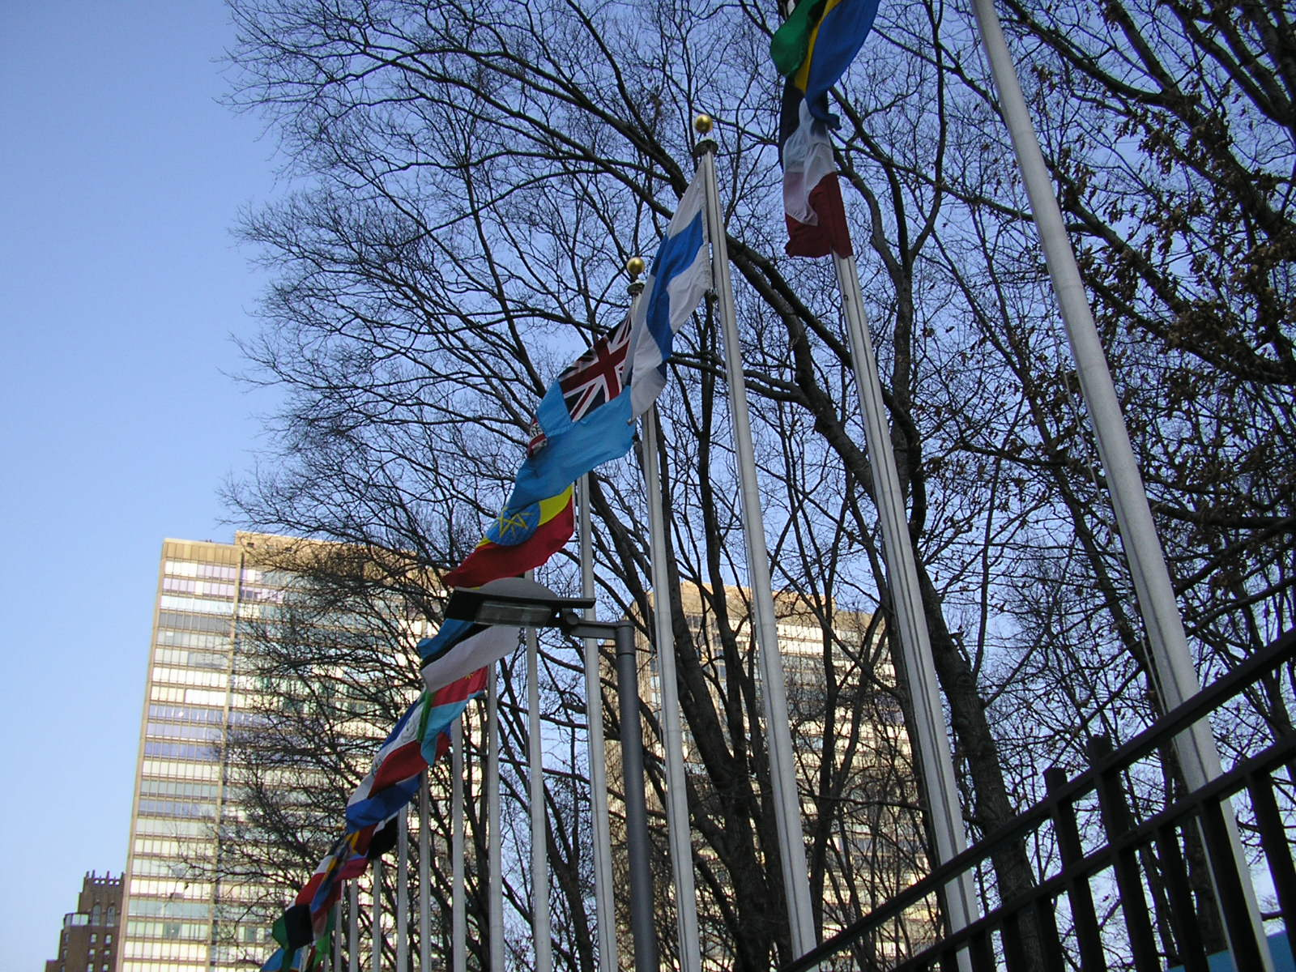
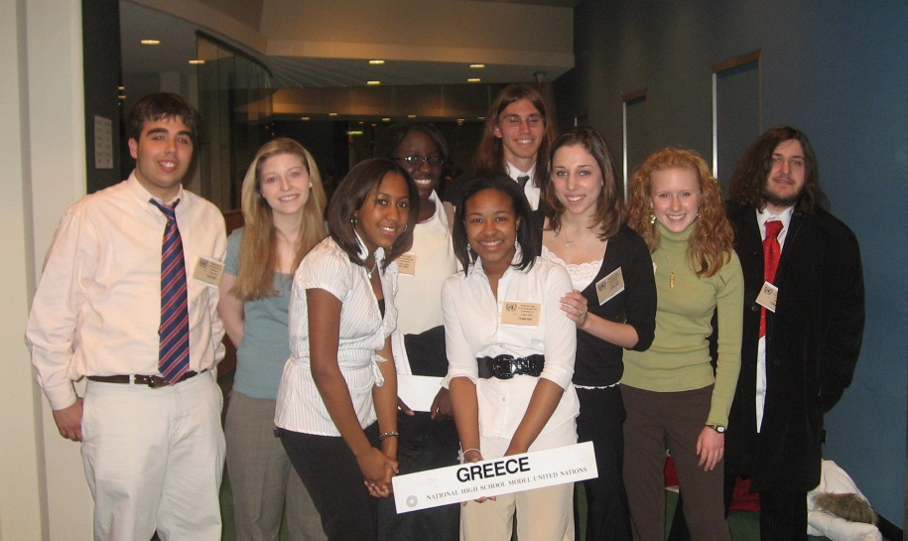
From Delegate to FA
Arkansas State University MUN Alums

Slide 27
Why Discourse…
Civics Is Not Enough: Teaching Barbarics in K-12.
Hibbing, John R and Theiss-Morse, Elizabeth.
PS: Political Science and Politics, v29 n1 p57-62 Mar 1996
Also see Diana Hess and Judith Torney Purta’s work.
Debate, negotiation, & compromise correlated to reports of pre-service teachers intent to combat young people’s lack of involvement in politics.
Dr. Charles Hartwig, Arkansas State University MUN Faculty Advisor
But perhaps best said by students themselves…

Slide 28
Student Reflections
Caden
&
Austin
Mary F
A

Slide 29
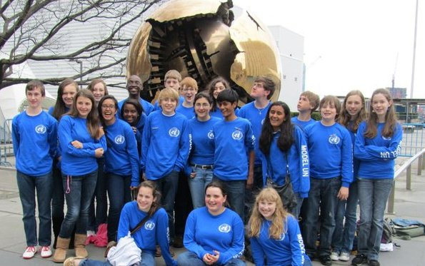
Questions

Slide 30

Contact Info: heathc@fultonschools.org pamelasroach@gmail.com

